Slide 1
NONCE RANGE

Slide 2
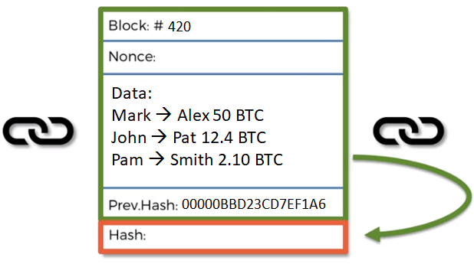
The nonce is a field in the block which allows miners to participate in the cryptographic challenge.
Miners cannot change any other field except for the nonce field and therefore they have to variate the nonce in order to generate a valid hash value.
As soon as that happens the miner wins the puzzle and can add the block to the chain and get the reward.
BUT, the nonce in not infinite, we can’t keep incrementing the nonce for ever.
The nonce is a 32 bit number which means there's only 32 bits of memory allocated in every single block for the nonce.

Slide 3
Without collisions, all of these 4 Billion nonces are going to generate unique hash values.
Is the nonce range enough to solve with 100% certainty the cryptographic puzzle??
The nonce is an integer which has a range.
It can only be anywhere between 0 and approximately 4 billion.
2³² = 4,294,967,296
32 bit number
0 – 4 Billion

Slide 4
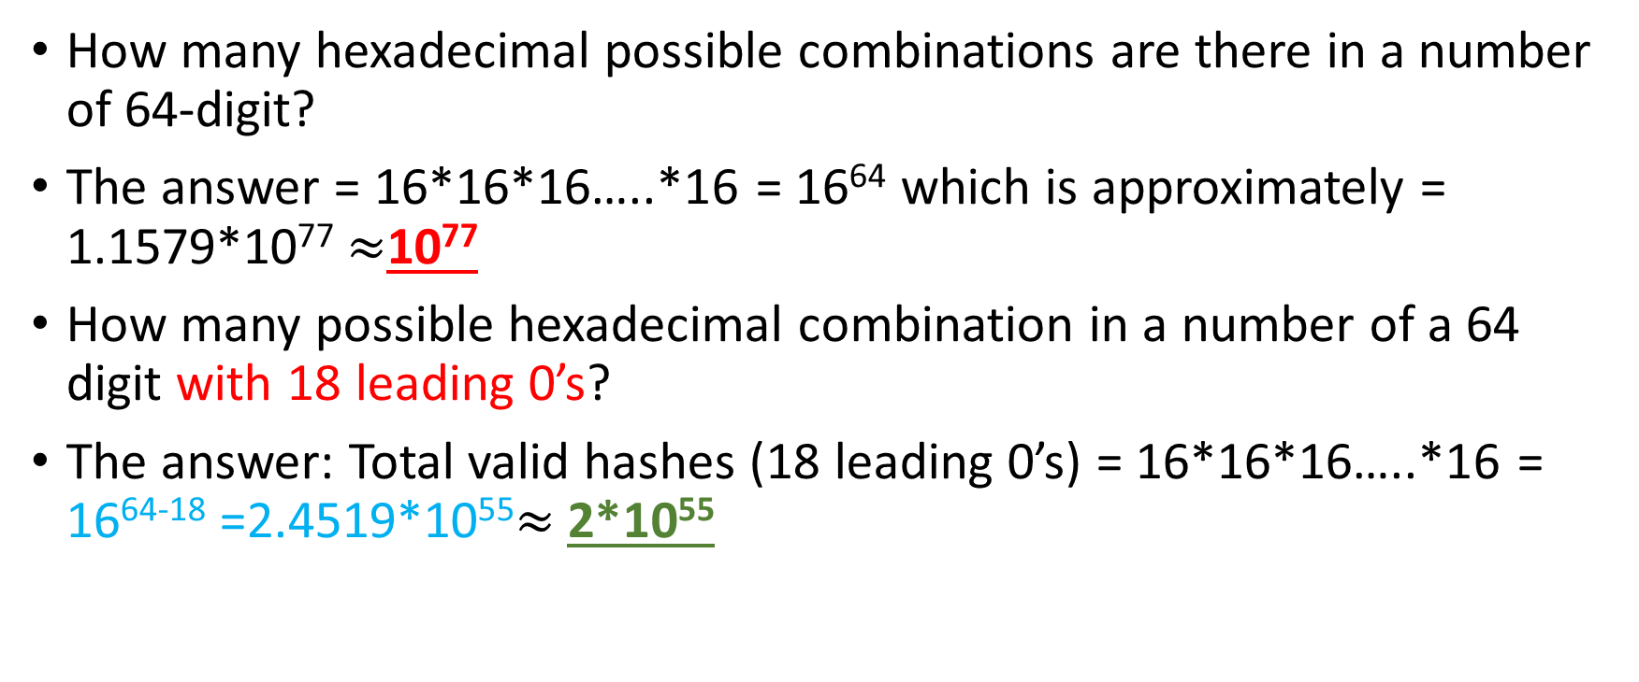
How many hexadecimal possible combinations are there in a number of 64-digit?
The answer = 16*16*16…..*16 = 16⁶⁴ which is approximately = 1.1579*10⁷⁷ $≈$10⁷⁷
How many possible hexadecimal combination in a number of a 64 digit with 18 leading 0’s?
The answer: Total valid hashes (18 leading 0’s) = 16*16*16…..*16 = 16⁶⁴⁻¹⁸ =2.4519*10⁵⁵$≈$2*10⁵⁵

Slide 5
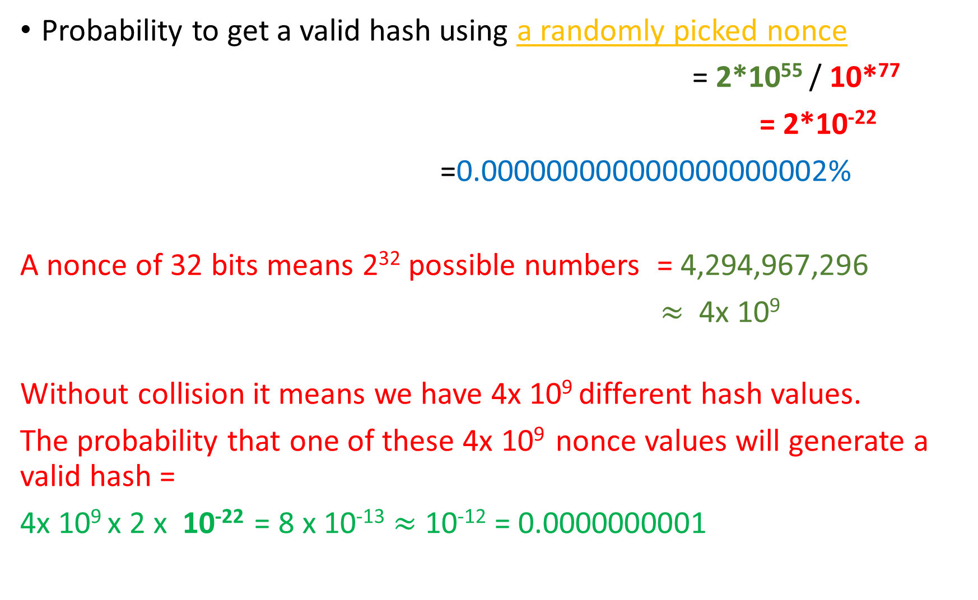
Probability to get a valid hash using a randomly picked nonce
= 2*10⁵⁵ / 10*⁷⁷
= 2*10⁻²²
=0.000000000000000000002%
A nonce of 32 bits means 2³² possible numbers = 4,294,967,296
$≈$ 4x 10⁹
Without collision it means we have 4x 10⁹ different hash values.
The probability that one of these 4x 10⁹ nonce values will generate a valid hash =
4x 10⁹ x 2 x 10⁻²² = 8 x 10⁻¹³ $≈$ 10⁻¹² = 0.0000000001

Slide 6
If we go through the whole range of the nonce from 0 to approximately 4 billion still its 0.0000000001 probability that we will find a solution to a cryptographic puzzle.
So the conclusion here is that the nonce is not enough, even if you go through the whole nonce range its still very unlikely to find the a valid target hash value.

Slide 7
If the probability (0.0000000001) is this small, will we get a solution??
What's the point of trying to solve it??
A modest miner (not the fastest not the slowest type of mining) does about 100 million hashes per second.
A modest miner ➔ 100 MHs
The nonce range is approximately 4 Billion numbers, so to try all these 4 Billion nonce values using a modest miner of 100 MH/s,
the time needed = 4 Billion / 100 MHs = 40 seconds!!
If no one of the nonce values was the golden nonce then what to do ?? Is this is the end??!!

Slide 8
To solve this problem, a new field is added to the block, the Timestamp.
The timestamp represents the time when a new block is mined, and the timestamp is updated every single second.
Every single second the information inside the block will be updated because the timestamp will increase by one second.

Slide 9
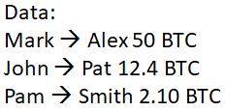

Block: #10
Timestamp:
Nonce: 0 – 4 Billion
Hash:

Slide 10
Based on the avalanche effect:
if we don't change the nonce or if we don’t change anything except the timestamp then if we rehash the block with the updated timestamp the resulted hash will be absolutely different.
Every single second we go through a certain number of nonces and then the timestamp changes so we can reuse the whole range of the 4 Billion nonces again.
By using the timestamp, there will be infinite number of combinations of time values and nonces, these different combinations will be tried till a valid hash value is found.

Slide 11
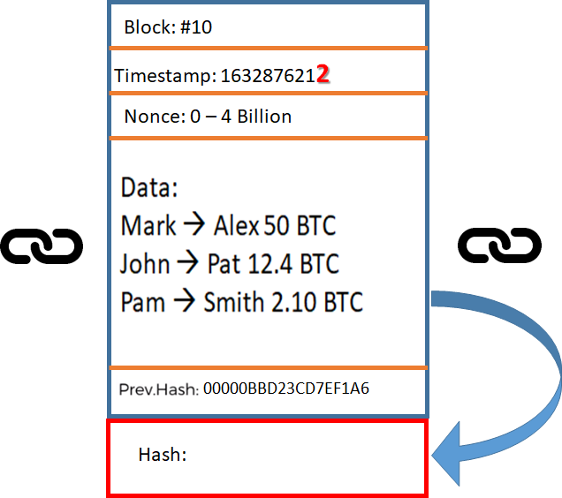



1 sec
1 sec
But, this solves the problem for a modest miner who can do 100 MH/s, What about the mining pools????
1632876212

Slide 12
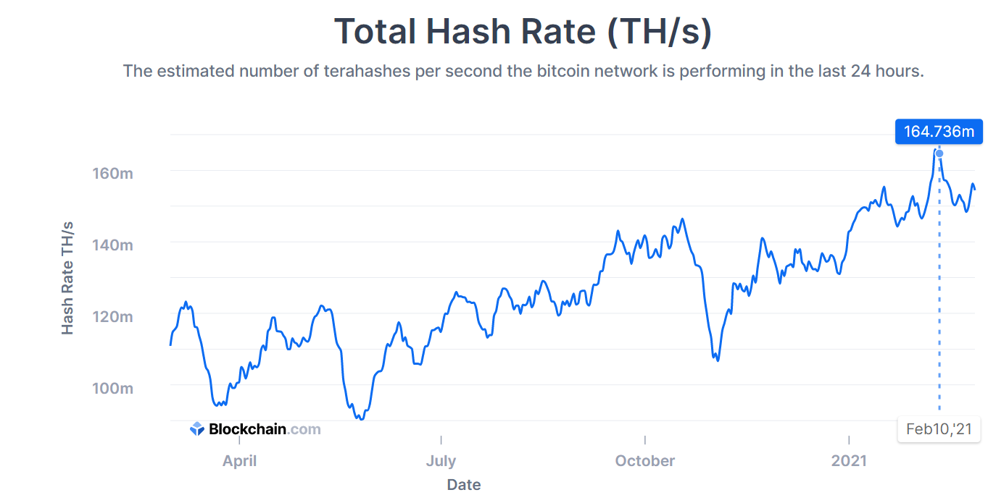
Hash Rate The estimated number of tera hashes per second (trillions of hashes per second) the Bitcoin network is performing. Source: blockchain.com

Slide 13
The current hash rate of the network is 164 million trillion hashes per second.
Even if part of the network hash power is considered, still it’s a tremendous hash power.
Such tremendous hash power will use all of the 4 Billion possible nonces in a very short time (much less than a second).
Then the mining pool has to wait till the timestamp updates to start again and this is so much of wasted computation power.
So What is the solution for a mining pool??

Slide 14


How Miners Pick Transactions
The transactions come from a MEMPOOL ( Memory Pool) which is attached to every node or miner.
Initially, the transaction in the MEMPOOL are unconfirmed transactions, they are stored in the MEMPOOL before they get included inside a block.
MEMPOOL
Transaction ID | Fees to Miner
2A34BC1 | 0.001 BTC
5BBD92A | 0.0003 BTC
C5B2D89 | 0.004 BTC
87DE27C | 0.0005 BTC
AC33B4D | 0.002 BTC
EF42231 | 0.002 BTC
5A13BD2 | 0.0008 BTC
C43ABC6 | 0.0007 BTC
E98DF17 | 0.003 BTC
DA4E5A1 | 0.0015 BTC
AA6677B | 0.0028 BTC

Slide 15
One blocks is added about every 10 minutes, but transactions happen all the time.
The user can send bitcoins any time and he\she can receive bitcoins any time, The user don't have to wait until every 10 minutes
All transactions are stored in a MEMPOOL until they get selected and added to a valid block (Pending Transactions).
MEMPOOL
Transaction ID | Fees to Miner
2A34BC1 | 0.001 BTC
5BBD92A | 0.0003 BTC
C5B2D89 | 0.004 BTC
87DE27C | 0.0005 BTC
AC33B4D | 0.002 BTC
EF42231 | 0.002 BTC
5A13BD2 | 0.0008 BTC
C43ABC6 | 0.0007 BTC
E98DF17 | 0.003 BTC
DA4E5A1 | 0.0015 BTC
AA6677B | 0.0028 BTC

Slide 16
The miner need to include some of these transactions in the block that he/she mines.
There is a maximum limit for the number of transaction that can be added to the Block.
In reality, for bitcoins, The limit is one megabyte size for the block, and this can take up to 2000 transactions.
MEMPOOL
Transaction ID | Fees to Miner
2A34BC1 | 0.001 BTC
5BBD92A | 0.0003 BTC
C5B2D89 | 0.004 BTC
87DE27C | 0.0005 BTC
AC33B4D | 0.002 BTC
EF42231 | 0.002 BTC
5A13BD2 | 0.0008 BTC
C43ABC6 | 0.0007 BTC
E98DF17 | 0.003 BTC
DA4E5A1 | 0.0015 BTC
AA6677B | 0.0028 BTC

Slide 17
Assume that a maximum of five transactions can be added to the Block.
There are fees that should be paid to the miner for including transactions in the miner’s Block.
Each transaction is identified by an ID and a fee that the owner of the transaction will pay for the miner for adding the transaction to the Block.
The fees are non-compulsory and they're specified by the users themselves who want to send the Bitcoins. The users can pay low, medium, or high fee.
The miners get these fees for adding the corresponding transactions when they are successful in creating a valid Block.

Slide 18

Obviously, the miners will pick the transactions with the highest fees attached.
Block to be mined
Block: #10
Timestamp:
Nonce: 0 – 4 Billion
MEMPOOL
Transaction ID | Fees to Miner
2A34BC1 | 0.001 BTC
5BBD92A | 0.0003 BTC
C5B2D89 | 0.004 BTC
87DE27C | 0.0005 BTC
AC33B4D | 0.002 BTC
EF42231 | 0.002 BTC
5A13BD2 | 0.0008 BTC
C43ABC6 | 0.0007 BTC
E98DF17 | 0.003 BTC
DA4E5A1 | 0.0015 BTC
AA6677B | 0.0028 BTC
Hash:

Slide 19
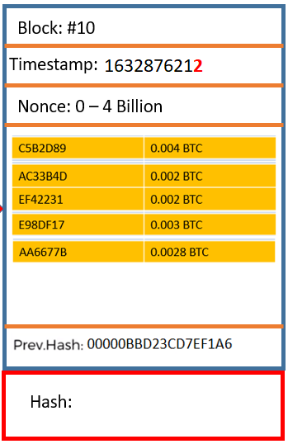
< 1 sec
The hash function is deterministic, same input always generate same output, what can be changed till now in the Block configuration is the nonce and the timestamp.
Mining pools have a huge hashing power that it can iterate over the 4 Billion possible nonces in less than one second, if the golden nonce was not found then either the mining pool should wait until the time stamp changes in order to test again the 4 Billion nonces, and this is considered a waste of time and hashing power.
OR???

Slide 20
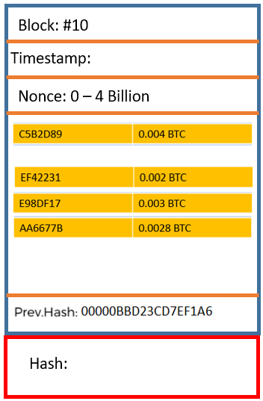

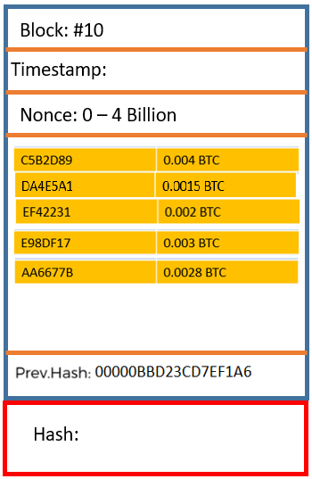
MEMPOOL
Transaction ID | Fees to Miner
2A34BC1 | 0.001 BTC
5BBD92A | 0.0003 BTC
C5B2D89 | 0.004 BTC
87DE27C | 0.0005 BTC
AC33B4D | 0.002 BTC
EF42231 | 0.002 BTC
5A13BD2 | 0.0008 BTC
C43ABC6 | 0.0007 BTC
E98DF17 | 0.003 BTC
DA4E5A1 | 0.0015 BTC
AA6677B | 0.0028 BTC
1632876212
< 1 sec
MEMPOOL
Transaction ID | Fees to Miner
2A34BC1 | 0.001 BTC
5BBD92A | 0.0003 BTC
C5B2D89 | 0.004 BTC
87DE27C | 0.0005 BTC
AC33B4D | 0.002 BTC
EF42231 | 0.002 BTC
5A13BD2 | 0.0008 BTC
C43ABC6 | 0.0007 BTC
E98DF17 | 0.003 BTC
DA4E5A1 | 0.0015 BTC
AA6677B | 0.0028 BTC
1632876212

Slide 21
What can be changed while waiting for the timestamp to change is one of the transactions.
The pool will replace the lowest fee transaction in the under mining block with the highest fee transaction that remained in the MEMPOOL.
This way the configuration of the Block has changed and again the 4 Billion possible nonces are available for testing to find the golden nonce.
The hashing power of the pool is not wasted anymore.

Slide 22
If the golden nonce was not found after replacing some transactions and the timestamp changed, then the process will start over by returning back the highest fees transactions to the Block and start looking for the golden nonce.

Slide 23
All of the previous steps are encoded in the algorithms that govern how people (nodes) are mining and it's part of the service offered by the mining pool.
If you redirect your hashing power into a pool you don't need to think about this, the advantages of a pool that they get rid of the headache for the miners.
The algorithm already knows how to allocate the transactions between the pool members.

Slide 24
Usually there are about 7000 transactions in each MEMPOOL, so the mining pool algorithm automatically combines the transactions in the best possible way in order to maximize the fees.
Also, the mining pool algorithm prevent the duplicate work for different miners in the pool.
The mining pool algorithm allocates the work (the nonces) to the miners, and it allocates the transactions.

Slide 25
if some user specifies very low fees for a transaction, then most likely the transaction will get stuck in the pool and no miner will ever use it.
Mining pools set a threshold for the transaction fee, it will not take a transactions below a certain threshold for their allocation.
If within 72 hours a transaction has not picked up by any miner then it’ll be released back to the user.

Slide 26
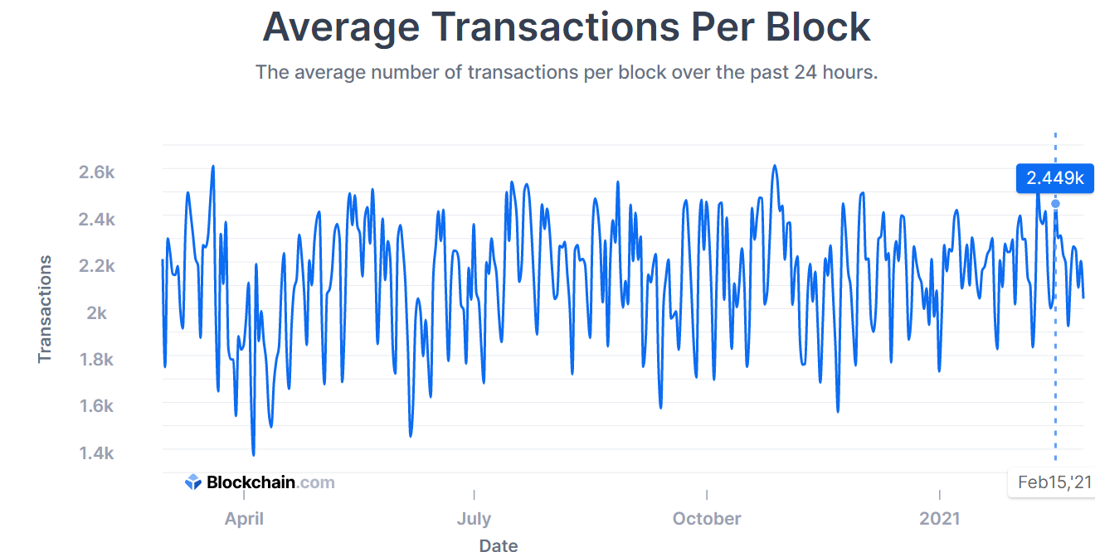
Average Number Of Transactions Per Block Source: blockchain.com

Slide 27
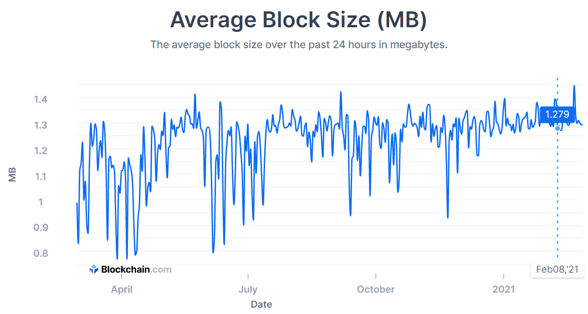
Average Block Size in MB Source: blockchain.com

Slide 28
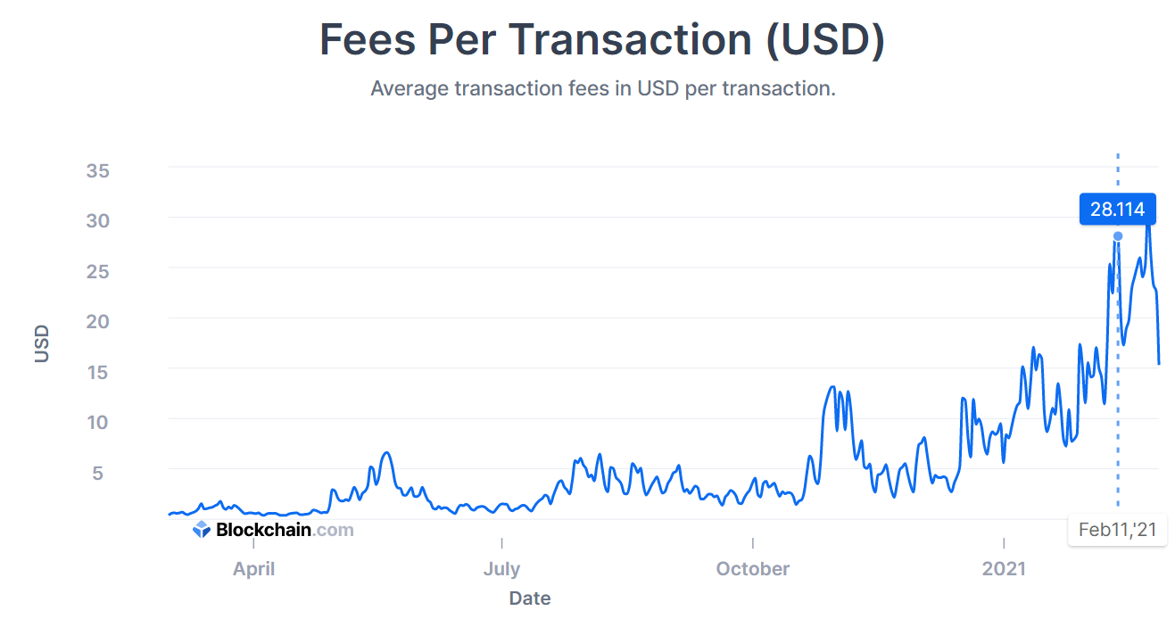
Total Transaction Fees in USD (not including the coinbase value of block rewards). Source: blockchain.com

Slide 29
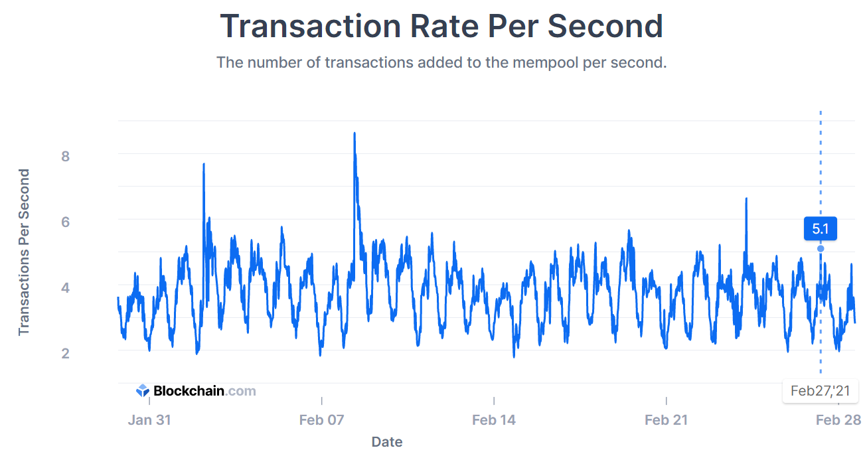
Transaction Rate The number of Bitcoin transactions added to the MEMPOOL per second. Source: blockchain.com

